Slide 1

Clustering and Applications to Biodiversity
Presented by: Alassane Ngaide, Frederic Anglade
Mentors: Dr. Urmi Ghosh Dastidar, Dr. Gene Fiorini

Slide 2
Basic Graph Definitions
Graph: a graph G is a set of vertex (nodes) v connected by edges (links) e. Thus G=(v , e).
Vertex (Node): Element of v
Edge (Link): An edge e is a link between two nodes.
Directed graph or directed graph: consists of vertices and edges with a flow of direction
Undirected graph: consists of a set of vertices and a set of edges with no direction
Cluster: Also called community, it refers to a group of nodes having denser relations with each other than with the rest of the network. A wide range of methods are used to reveal clusters in a network.

Slide 3
FOOD WEB
Food web: A directed graph representing an ecological community with arrow pointing from the preys towards the predators
Each organism in a food web depends for food on one or many other organisms in an ecosystem.
Predators: Eat preys
Preys: Provide energy for predators

Slide 4
Example of Food web Digraph
A digraph is a directed
Graph.
Shark
Sea otters
Sea urchins
Large crab
Small fish
kelp

Slide 5
COMPETITION GRAPH
Competition Graph: is a graph where the vertices are species in the ecosystem and there is an edge between two vertices if they have a common prey. If vertices are isolated, they either do not have any prey in common with the other species of the ecosystem or they are primary producers
Weighted Competition graph: A graph that associates a weight with every edge in the competition graph. Weight shows the number of shared preys among the associated predators (nodes).

Slide 6
How to Obtain a competition Graph
Food web Diagraph
Weighted Competition Graph
1
1
4
2
2
3
3
5
2
7
1
1
5
1
6
8
4
7
6
8

Slide 7
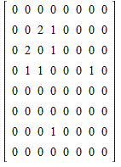
Adjacent Matrix of the
Weighted competition Graph

Slide 8
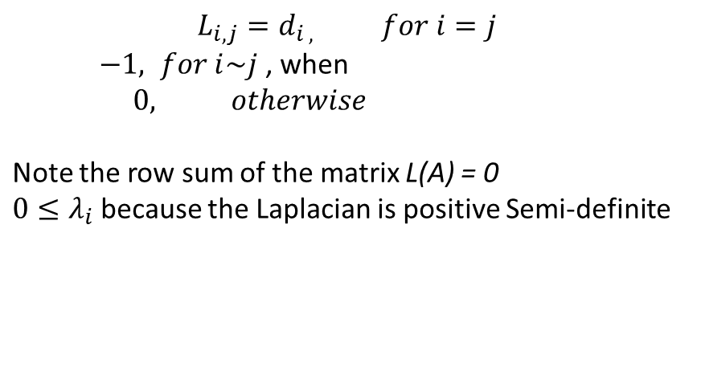
Laplacian
Given A, the Laplacian matrix L is defined as:
Notes:
The diagonal elements are the degree of each node i.e. if the node 1 has 4 edges then the degree of the node 1 is 4. When the node i is adjacent to the node j, then the value is -1, otherwise the values are zero.

Slide 9
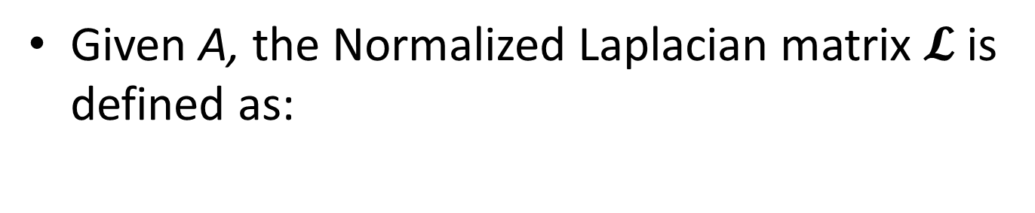
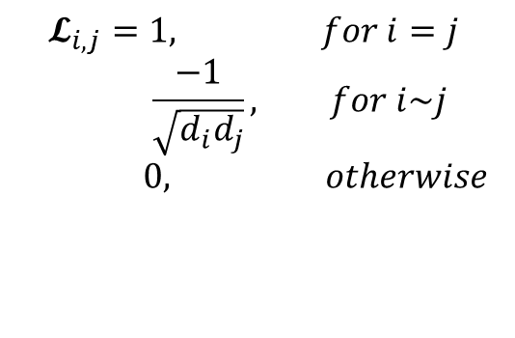
Normalized Laplacian
Presented by: Alassane Ngaide, Frederic Anglade
Notes:
You normalized each element of the Laplacian matrix here. All diagonal elements are 1. If the nodes are adjacent then it is -1 divided by the square root of the product of di and dj; otherwise, 0

Slide 10
Spectral clustering
Uses information obtained from the eigenvalues and eigenvectors of their adjacency matrices (obtained from the competition graph) for partitioning of graphs
Basic spectral bi-clustering algorithm:
The following algorithm partitions a graph into two clusters, nodes within the same cluster vertices are more connected to each other than with those in the other cluster. Particularly for the competition graph, the competition among species within the same cluster would be higher than with the species those belong to the other cluster.
Input: Weighted Laplacian Matrix
Find the eigenvector v corresponding to the second smallest eigenvalue for one of the following problems:
Lv = λv (L: Laplacian),
L’’v = λv (L’’: Normalized Laplacian).
Output: Clusters A = {j;vj>=0} and A’ = {j;vj<0}.
Notes:
We already have these results from the previous studies. We develop the competition graph from the Hudson food web, and then build the adjacency matrix of the competition graph, omit the zero rows and zero columns since these species are not competing and then use spectral bi-clustering algorithm. Input the adjacency matrix of the competition graph, calculate the Laplacian and normalized Laplacian, and then calculate the eigenvalues. The eigenvector associated with the second smallest eigenvalue is called the Fiedler vector. The values of these eigenvector essentially provides the partition. The nodes associated with the non-negative elements of this vector belong to one cluster and the nodes associated with the negative values of this vector belong to the other cluster. But, usually this cut is not balanced. We can get skewed cut meaning there may be two or three nodes in one partition and all other nodes in the other cluster.

Slide 11
Fiedler order is believed to provide the best linear search order for finding the optimum cut. However, it is possible to have nodes sharing higher linkage to the other cluster than the one they are currently assigned to by using only the information of Fiedler order.
It is observed that a linkage differential order provides a better ordination than the Fiedler order (still to explore).
Plan to implement a combination of Fiedler order with linkage differential order for analyzing competition graph
Presented by: Alassane Ngaide, Frederic Anglade

Slide 12
Problem
Given the competition graph G = (V,E) (based on Hudson River data sets) with the node set (species) V, edge set E, and the weight matrix W (W_{ij} = number of shared preys between i^{th} and j^{th} predators), is it possible to partition the competition graph G into two subgraphs G_{A} and G_{B} using a combination of Fiedler order and linkage-based refinements to minimize cut(A,B) while maximizing W(A) and W(B) at the same time? The strength between two nodes (species) is given by their edge weight (W_{ij}) and the strength between two clusters A and B is given by

Slide 13
Reference:
“Food Webs, Competition Graphs, and Habitat Formation” Margaret B. Cozzens, DIMACS, Rutgers University
Nir Ailon, Moses Charikar, Alantha Newman.(2008). Aggregating inconsistent information: Ranking and clustering. J. ACM 55(5)
Ding. C. HQ et al..(2001). A Min-max Cut Algorithm for Graph partition and clustering. IEEE conference Proceeding. pp . 107-114
Chung, F. R. K. (1997). Spectral graph theory. Providence, RI: American Mathematical
Society.
Dy, J. G., & Brodley, C. E. (2004). Feature selection for unsupervised learning.
J. Mach. Learn. Res., 5, 845–889.
Hagen, L., & Kahng, A. (1992). New spectral methods for radio cut partitioning and clustering. IEEE Transactions on Computer-Aided Design, II(9), 1074–
1085.

Slide 14
Thank You for your Attention

Slide 15
Problem
Given the competition graph G= (V, E) based on the Hudson river data sets with the node set (species) V, edge set E, and the weight matrix W (Wij = number of shared preys between ith and jth predators), it is possible to partition the competition graph G into two sub graphs GA and GB using the combination of Fiedler order and linkage-based refinements to minimize cut (A, B) while maximizing WA and WB at the same time
The strength between two nodes (species) is given by the edge weigh (Wij) and the strength between two clusters is given by: cut (A,B) =W(A,B) where:
W(A,B) = ∑Wij, iЄ A, jЄ B WA = W(A,A)
Both these requirements can be satisfied by the objective function:
Mcut = cut(A,B)/WA + cut(A,B)/WB
The above is called the min-max cut function. It minimizes the cut between two clusters while maximizing the connection within the cluster

